Slide 1

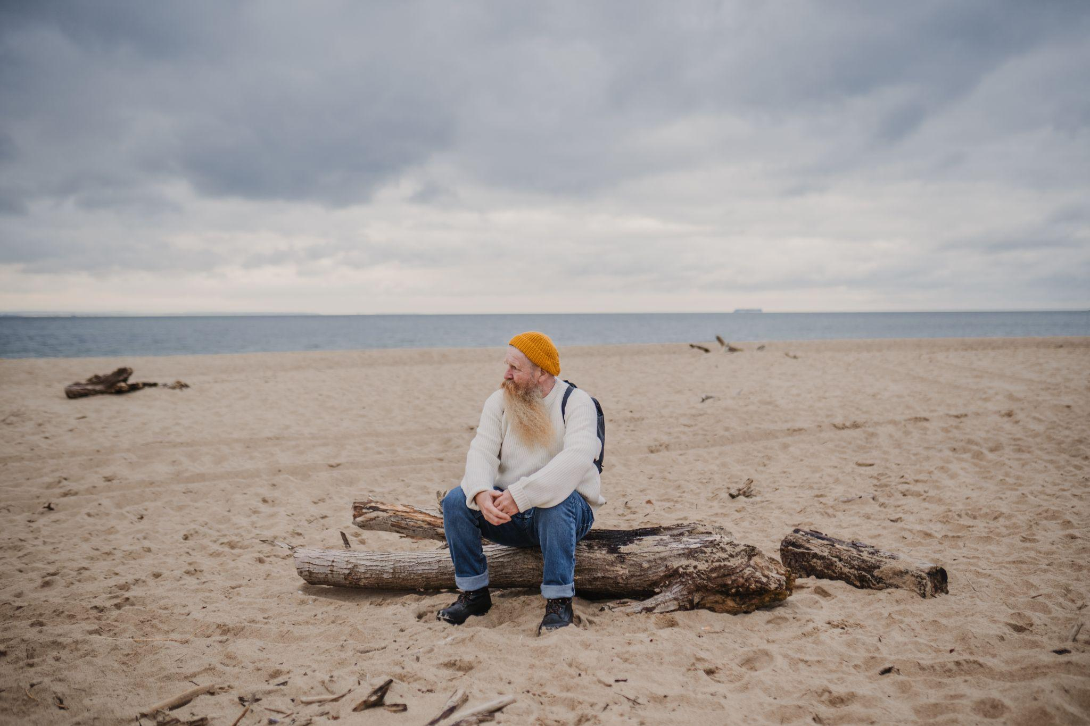

Slide 2

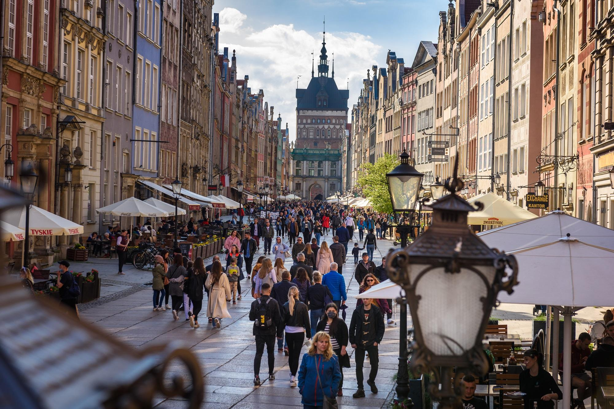
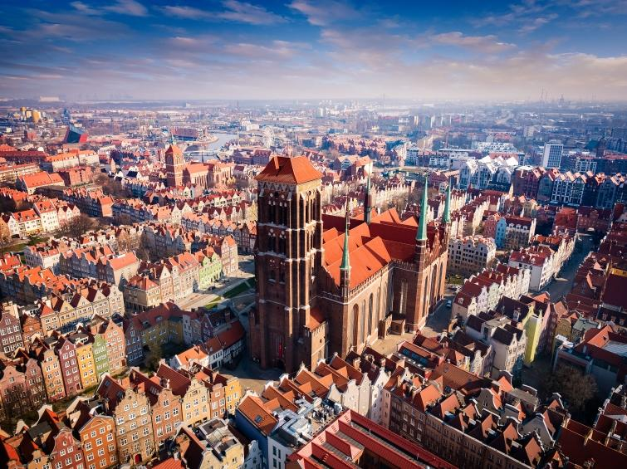
Gdansk Tourism Organization
GOT Mission
We promote Gdansk as a dynamic and sustainable tourist destination at the local, national and international level. We strive for harmony between residents and tourists and strengthen the city's position as a unique centre of sustainable and business tourism. We are inspired by new trends and seek innovative solutions, focusing on sustainable development that benefits both the local community and tourists and visitors.
GOT Vision
Our vision is to make Gdansk a model of sustainable tourism, where an innovative approach is combined with care for the local community and environment. We want Gdansk to be recognized as a leading destination for business and recreational tourism, offering unique experiences that inspire and engage visitors.
Uczniowska 22, 80-530 Gdańsk tel. +48 58 305 70 80 got@visitgdansk.com www.visitgdansk.com

Slide 3
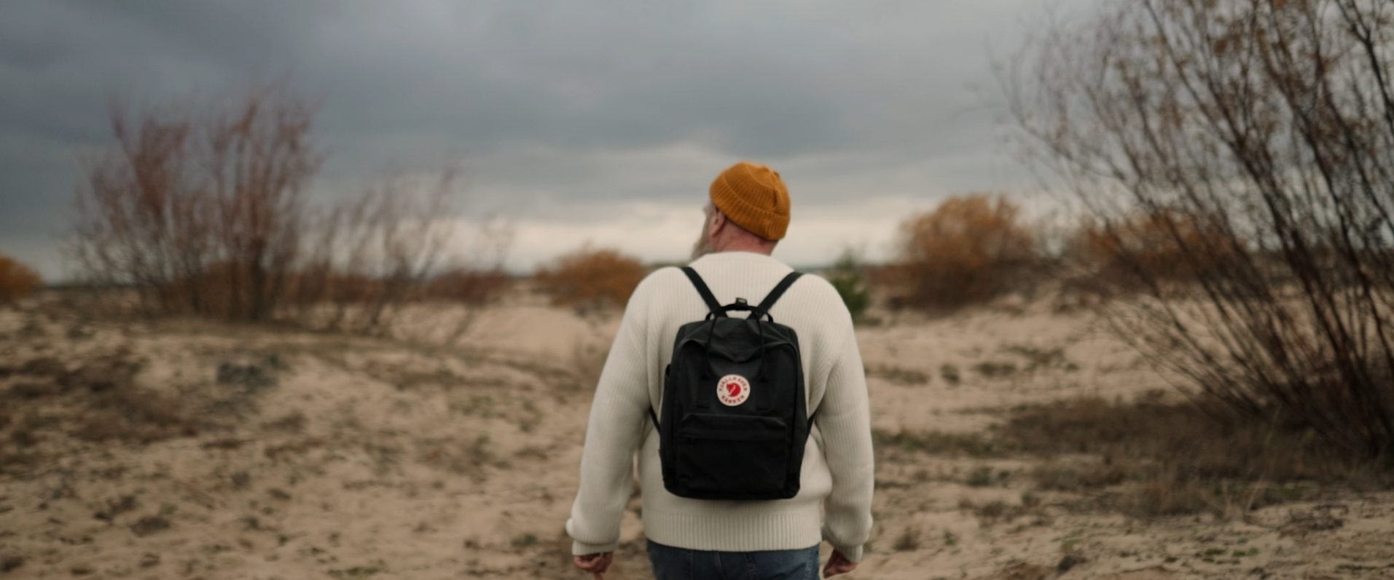

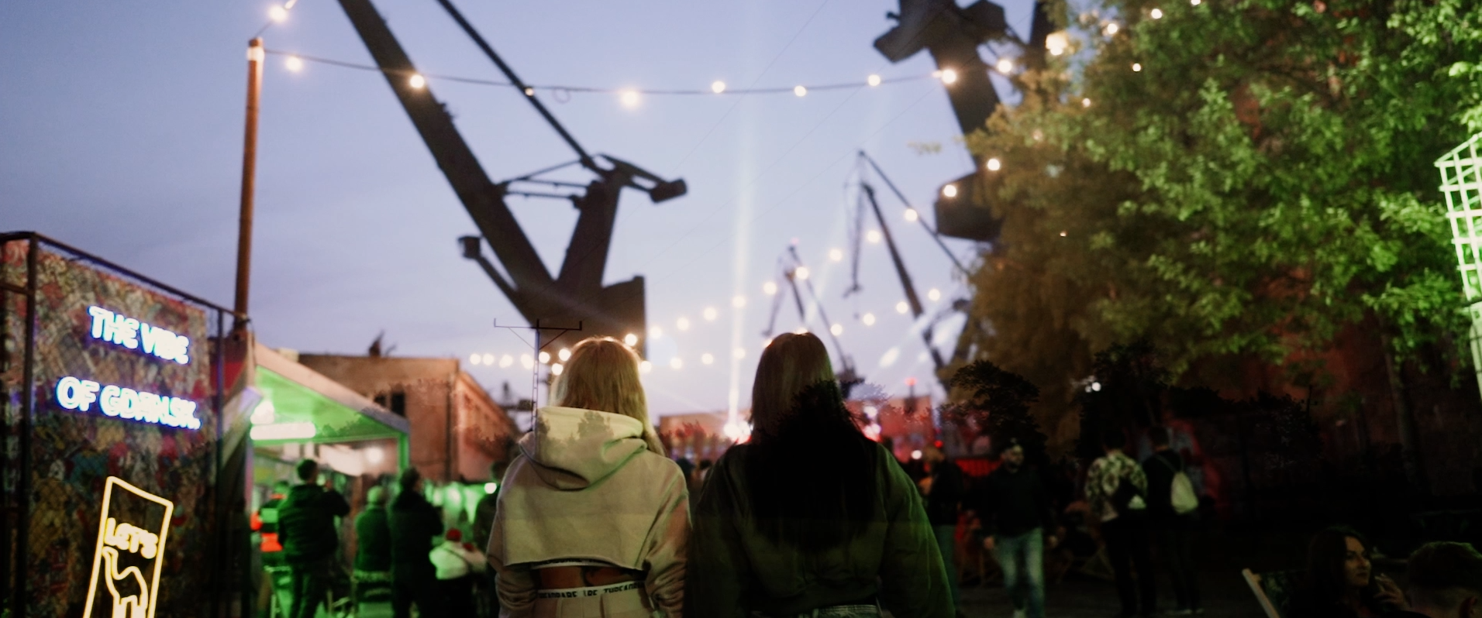
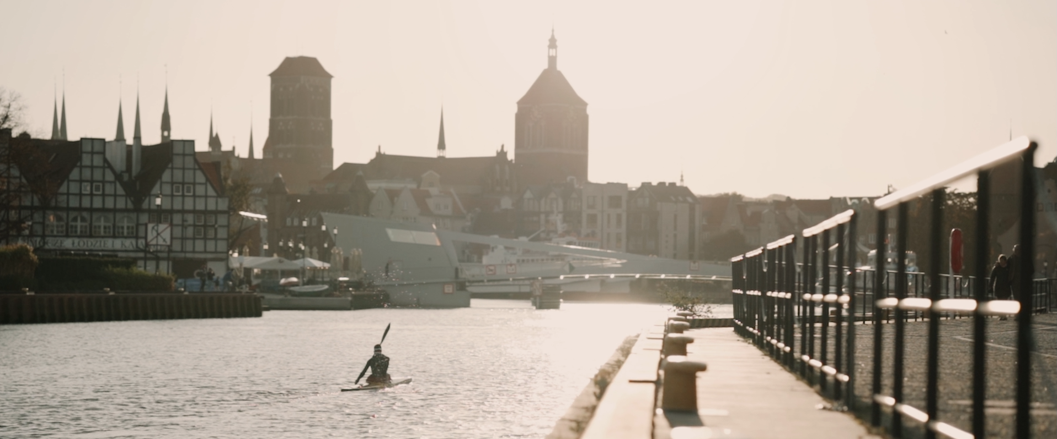
Our strategy
we play a key role in promoting Gdańsk locally, across Poland, and internationally
We care about maintaining a balance between residents and tourists
we strengthen Gdańsk’s position as an exceptional business tourism destination
we focus on the sustainable development of tourism
we cooperate with the local industry, we care about education, development, networking
we follow new trends, inspire, and seek innovative solutions
we promote and uphold the values that matter to Gdańsk and to the members of our Association
Uczniowska 22, 80-530 Gdańsk tel. +48 58 305 70 80 got@visitgdansk.com www.visitgdansk.com

Slide 4
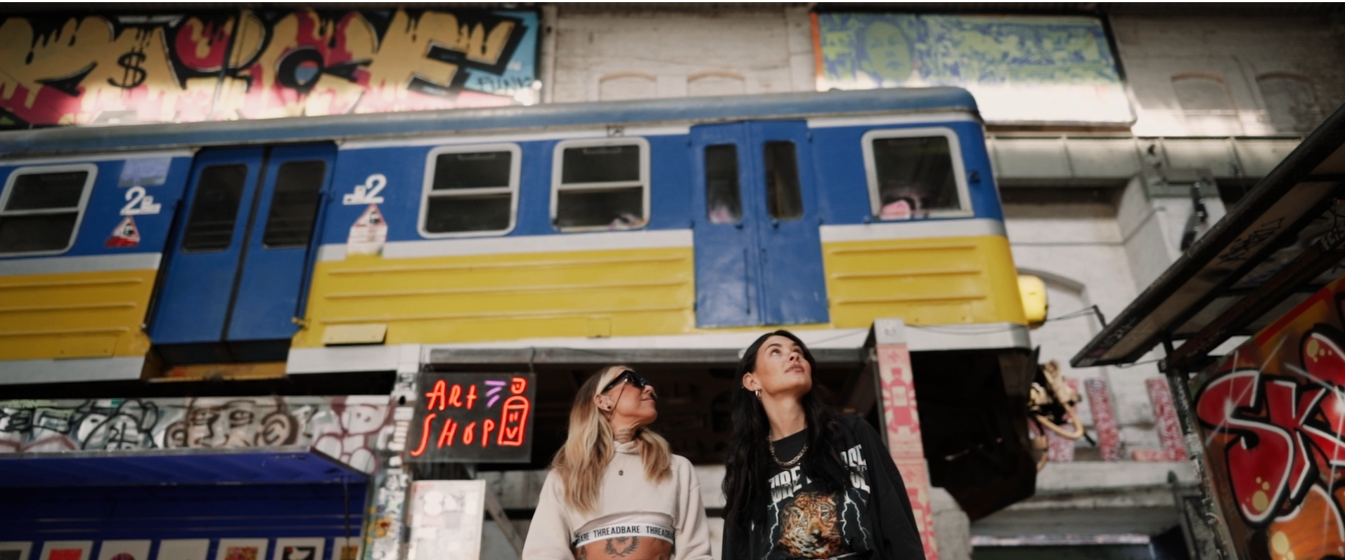
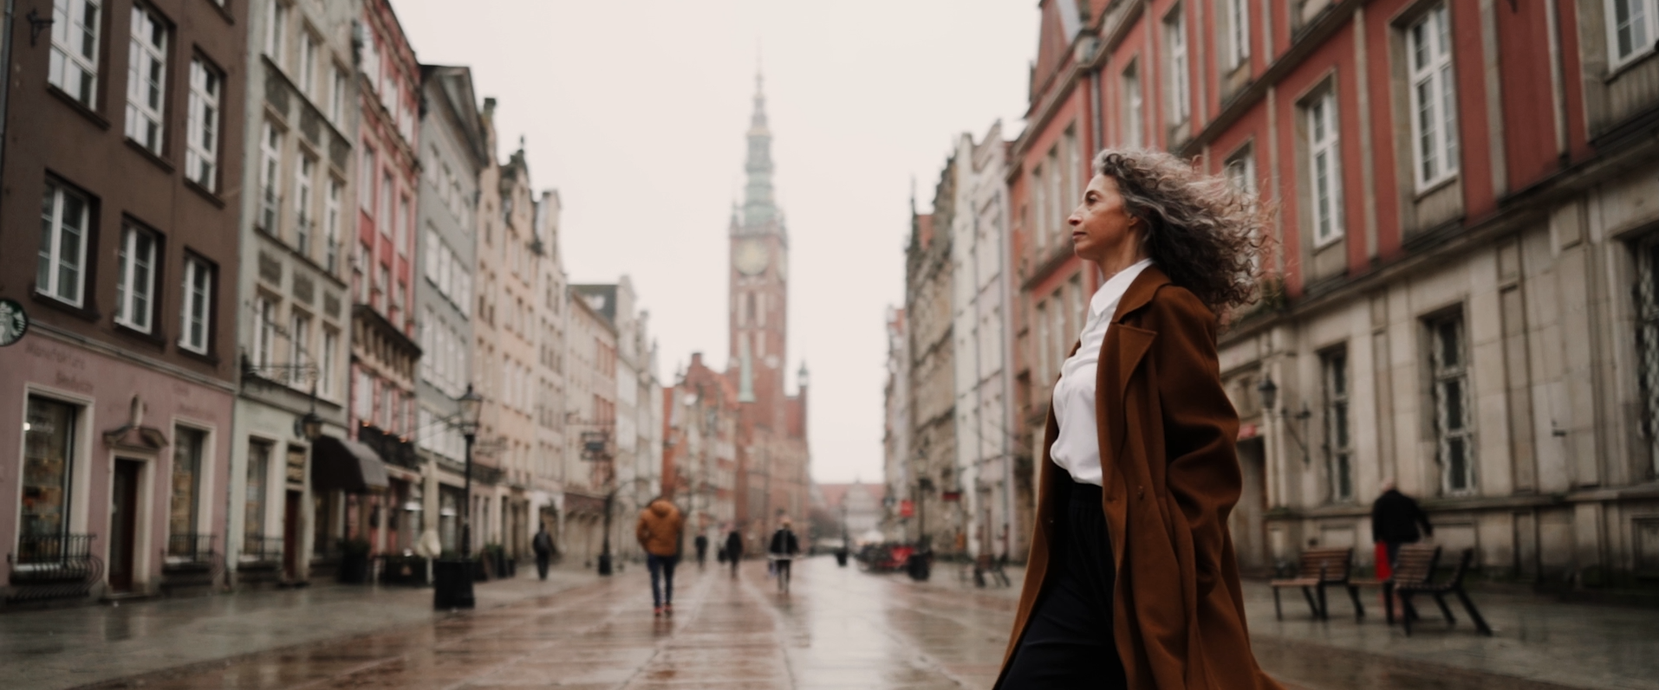
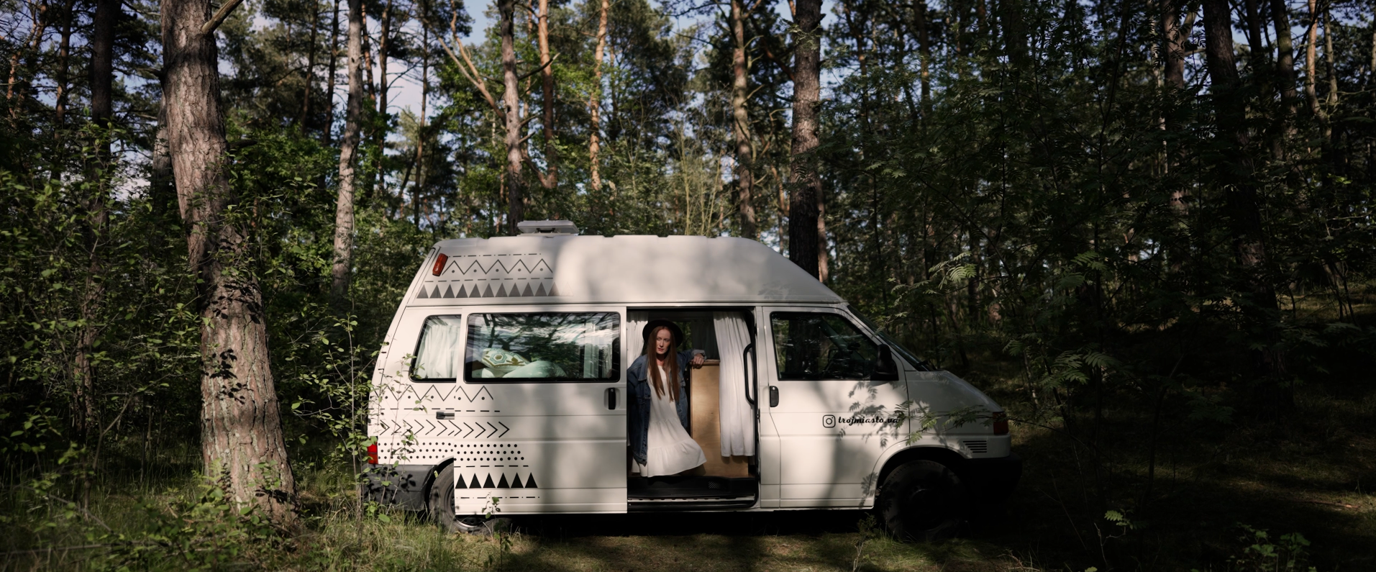
Our strategy
Sustainable development of tourism in Gdansk
Conscious shaping of the image of Gdansk as a sustainable
and accessible destination
Development of sustainable individual tourism and leisure time offer
(individual tourist, local tourist, resident)
Development of the Meetings Industry (MICE)
Strengthening cooperation with local entrepreneurs, universities
and institutions, especially in the area of ​​sustainable development of tourism and strengthening awareness of accessibility
Observation, research and proposing innovative solutions in line
with tourism development trends and challenges of the future
Uczniowska 22, 80-530 Gdańsk tel. +48 58 305 70 80 got@visitgdansk.com www.visitgdansk.com

Slide 5
Who we are?
Association with 186 members
Uczniowska 22, 80-530 Gdańsk tel. +48 58 305 70 80 got@visitgdansk.com www.visitgdansk.com

Slide 6

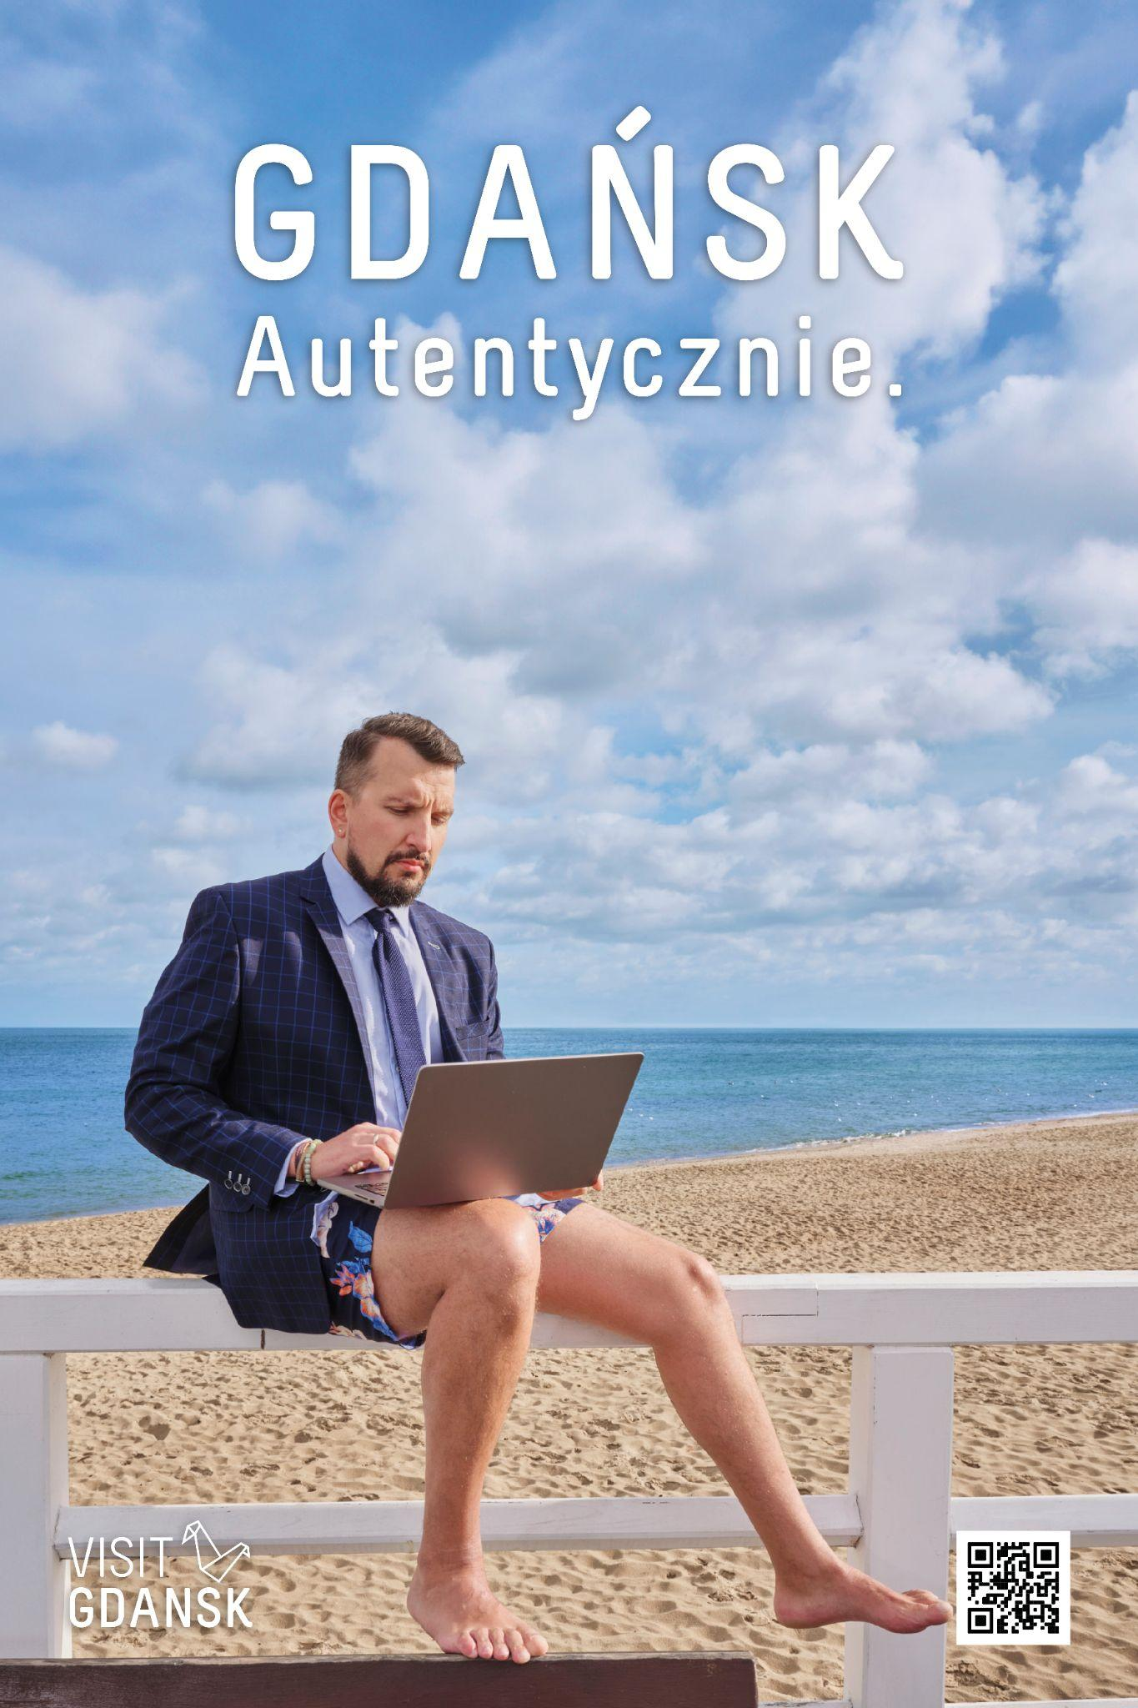

GDANSK. Authentically
Goals:
Extending the tourist season beyond the holiday months
Moving tourist traffic outside the areas most crowded during the season
Promotion of the new Visit Gdansk website and directing traffic to it
Directing traffic to the Tourist Card website
Directing traffic to the Visit Gdansk e-shop website
Activities:
Website development
Promotional film
Graphic identification - photo session, web banners
Google Ads campaign (promotion of the film, directing traffic to the website) and Facebook and Instagram (content referring to the photo session)Outdoor campaign - CityLights in Warsaw, Lodz, Poznan, Kraków, Wroclaw - campaign from April 2024
Campaign in industry media + journalist visits
Influencer marketing - cooperation with influencers with smaller audience bases
foreign promotion
Outdoor campaign – city-lights in the largest cities in Poland (Warsaw, Lodz, Poznan, Krakow and Wroclaw).
Uczniowska 22, 80-530 Gdańsk tel. +48 58 305 70 80 got@visitgdansk.com www.visitgdansk.com

Slide 7

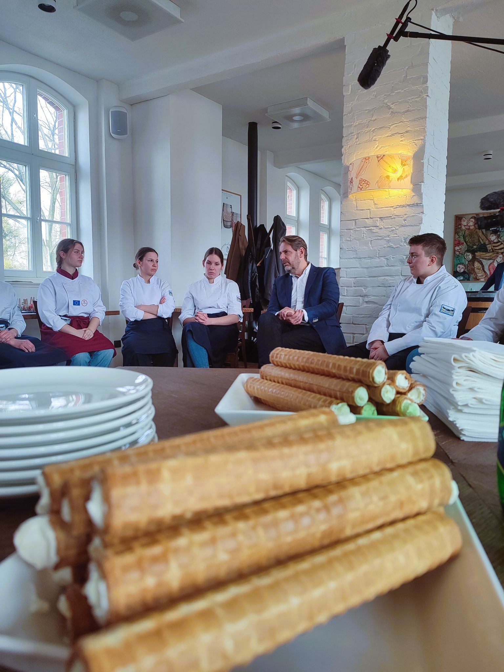
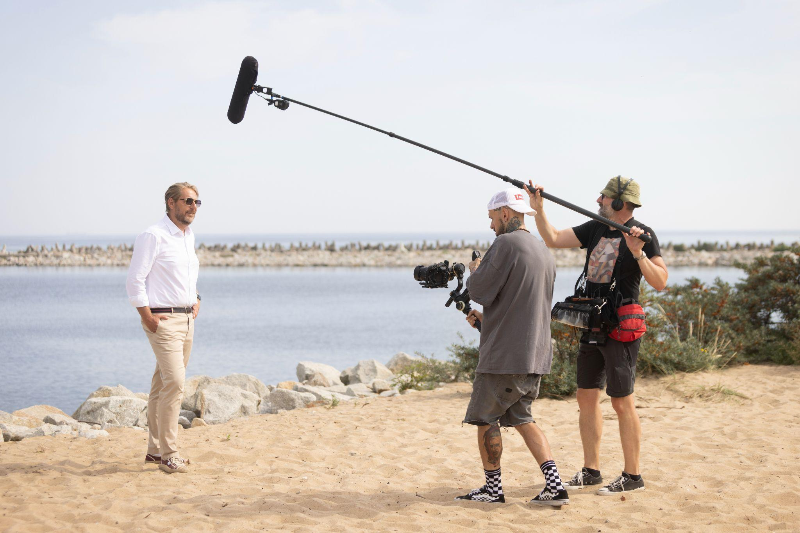
Tastes of Gdansk
Communication goals:
building the concept of culinary tourism
increasing package sales
promoting local products and gastronomy
driving traffic to the project subpage
Activities:
publication of further promotional films with the project ambassador - Wojciech Modest Amaro (beach and Main City)recording and publishing two vlogs from Modest Amaro's visits to Gdansk (March, May 2024)
organizing interviews with the project ambassador (TV - DDTVN, podcasts)
outdoor and public transport advertising (e.g. citylights, banners)
cooperation with local chefs
publication on Facebook Visit Gdansk of articles on interesting facts related to Gdansk's cuisine
paid campaign on Google Ads and Social Media
seasonal promotion of the project and package, including a Valentine's Day edition.
Uczniowska 22, 80-530 Gdańsk tel. +48 58 305 70 80 got@visitgdansk.com www.visitgdansk.com

Slide 8

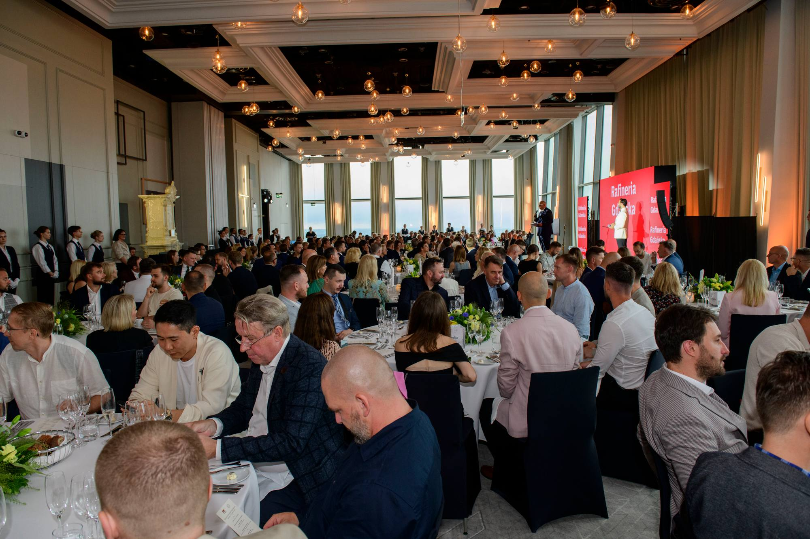
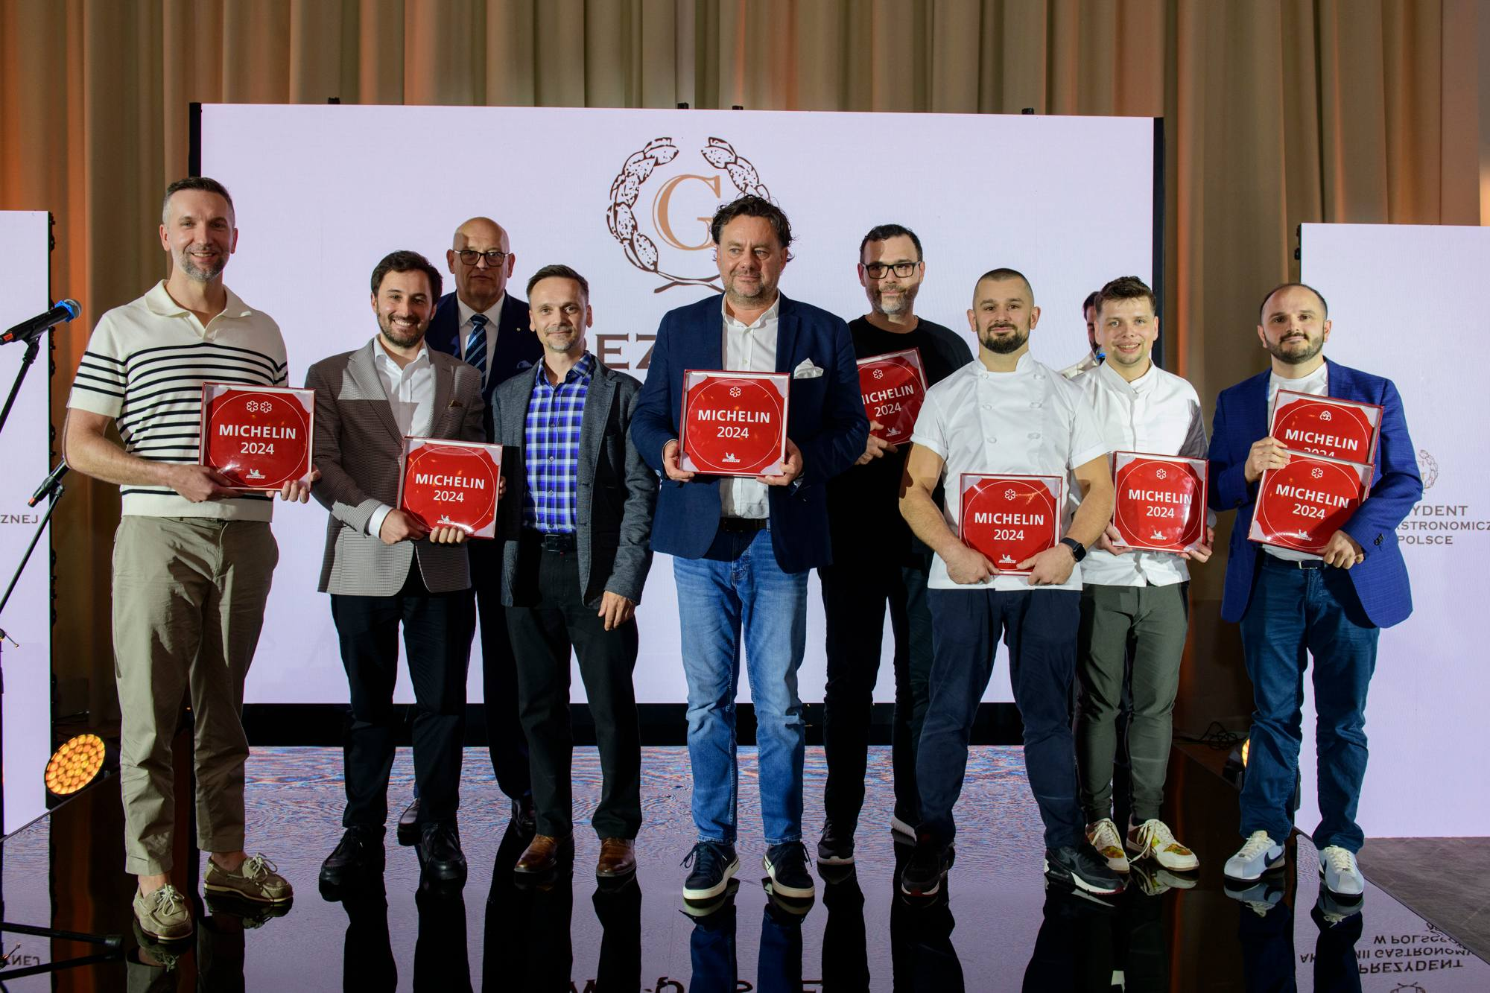
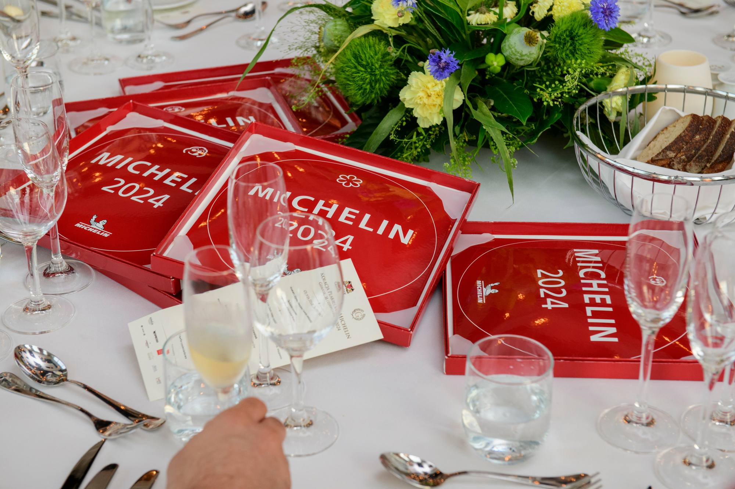
Michelin Guide
Gdańsk has joined the group of Polish cities whose restaurants have been assessed by the Michelin Commission. The appearance of the Guide in Gdansk is an appreciation of the city's many years of consistent and hard work in the field of gastronomy and culinary tourism.
On June 20, we learned about regional restaurants, including Gdansk, that have been awarded Michelin stars. On June 28, the awards gala took place at Olivia Star. It was the best opening (our region had not been assessed before) in Poland.
In Gdansk, we gained: 1 Michelin star, 1 Green Michelin Star (first in Poland), 8 recommendations and 2 Bib Gourmand awards.
The ceremonial gala took place on June 28 at Olivia Star.
Uczniowska 22, 80-530 Gdańsk tel. +48 58 305 70 80 got@visitgdansk.com www.visitgdansk.com

Slide 9

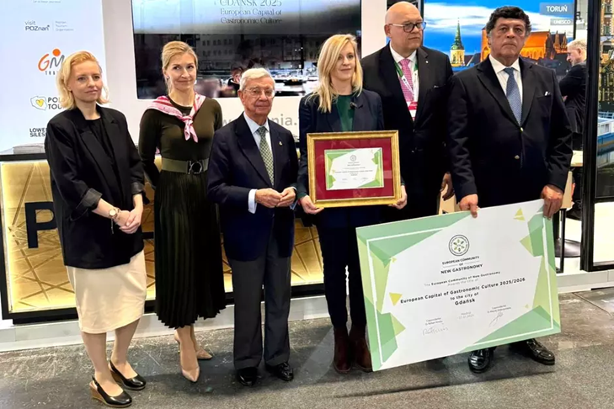
European Capital of Gastronomic Culture
Gdansk, a city with a rich history and culinary tradition, won the prestigious title of "European Capital of Gastronomic Culture 2025" in January. This distinction, awarded by the European Community of New Gastronomy, is a recognition of exceptional achievements in the field of culinary arts and the promotion of local cuisine. Previously, the title was held by cities such as Stockholm and Madrid.
In 2025, Gdansk will host numerous culinary events, festivals, workshops and exhibitions that will attract tourists and lovers of good cuisine from all over the world. The title is associated with many events that have been planned in Gdansk. These include:
• organization of the Fifth European Gastronomic Congress,
• organization of the Gastronomic Competition for the Grand Prix of the President of the City of Gdansk,
• tourist and gastronomic events tailored to the brand,
• inauguration of the Gastronomic Social Economy project integrating the excluded,
• organization of a competition for publications in the digital space and animation of social media,
• workshops with international, "star" chefs from different parts of Europe,
• study tour of Gdansk restaurateurs to Madrid.
Uczniowska 22, 80-530 Gdańsk tel. +48 58 305 70 80 got@visitgdansk.com www.visitgdansk.com

Slide 10
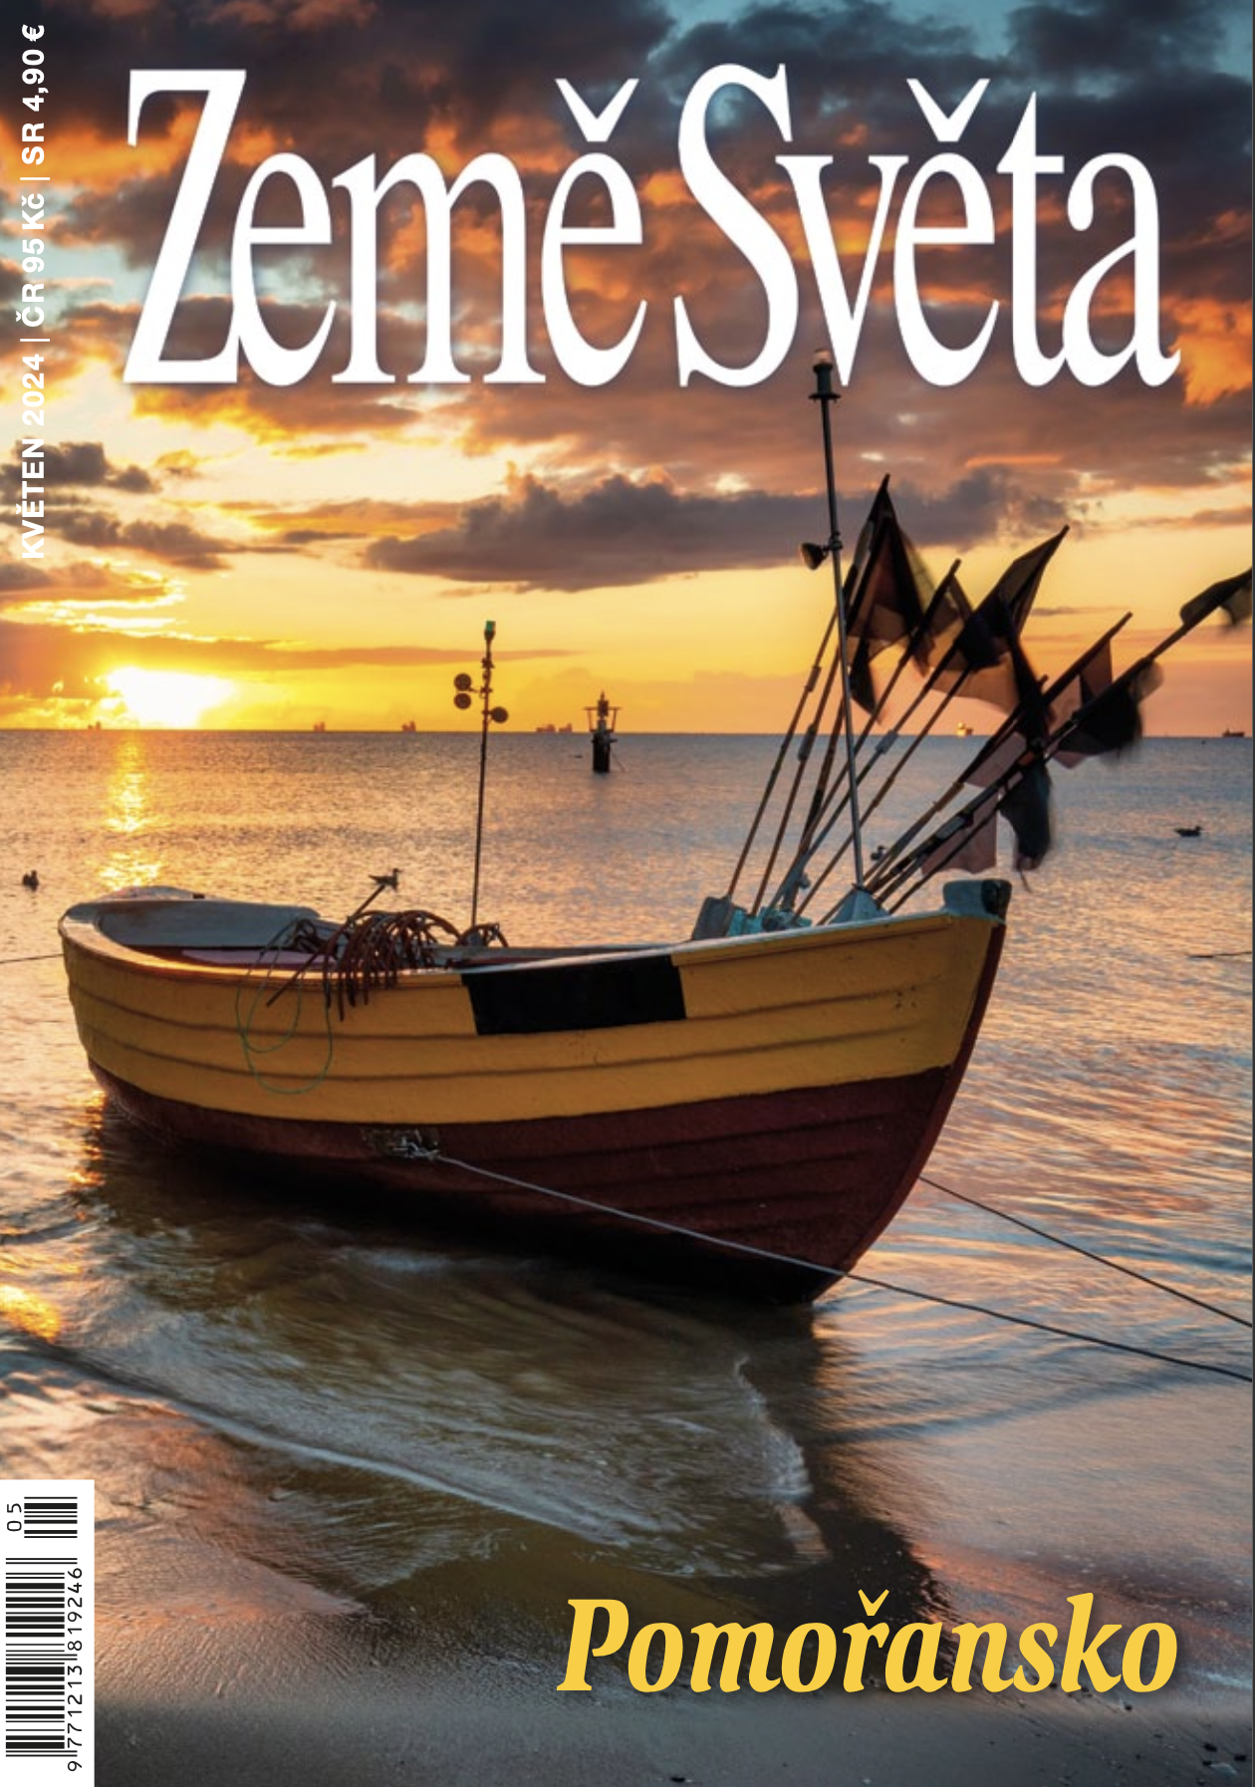
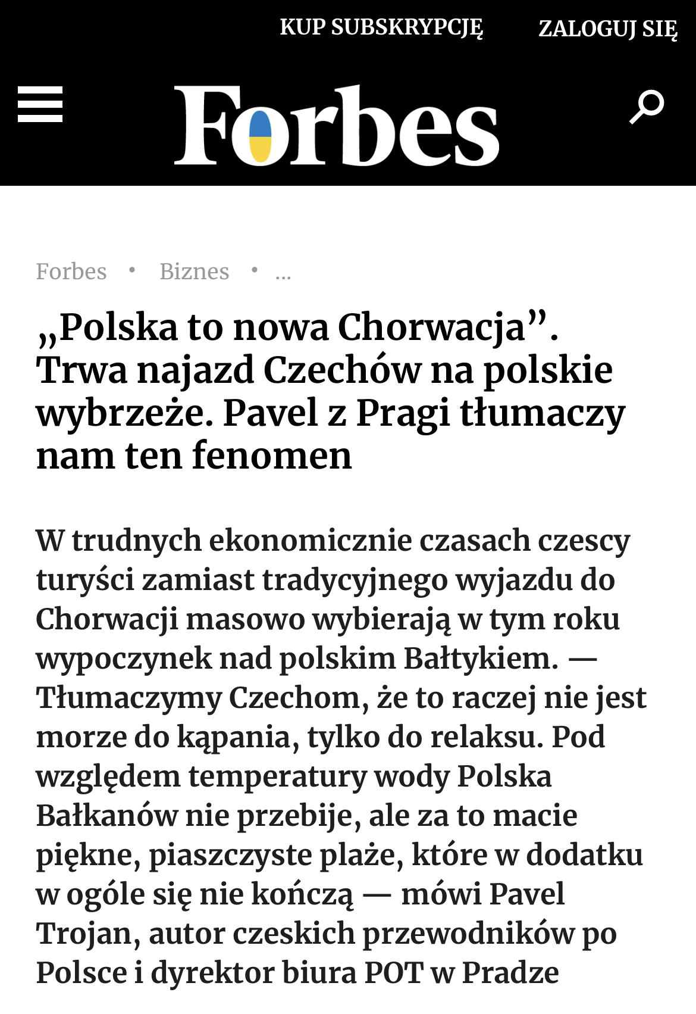
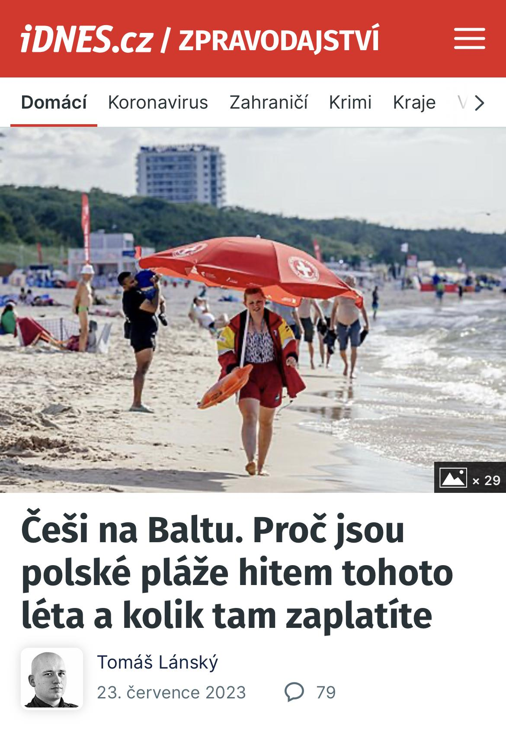
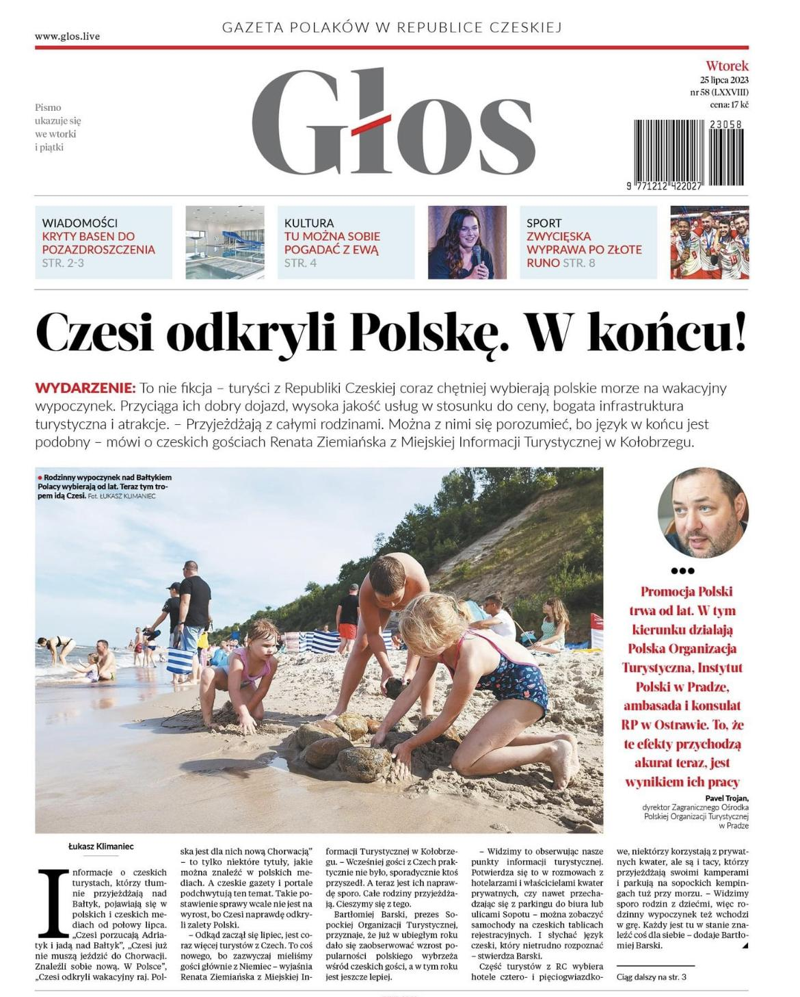
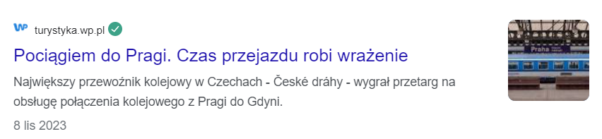
Foreign promotion
Direction - Czechia
Czechs are changing their holiday destination - they are looking for an alternative to the Adriatic.
They are increasingly choosing the Baltic Sea and northern Poland for their holidays due to convenient air and road connections, competitive prices, characteristic sandy beaches and a specific tourist offer.
An additional advantage of Gdansk for the Czechs is the launch of a direct Prague-Gdansk rail connection in December 2024.
Activities:
cooperation with ZOPOT Prague - organization of stays for journalists from the Czech Republic and Slovakia
What do we promote?
nature and active leisure regardless of the season
tourist attractions of the Main City and beyond
Tastes of Gdansk, in response to the development of culinary tourism / Michelin.
Uczniowska 22, 80-530 Gdańsk tel. +48 58 305 70 80 got@visitgdansk.com www.visitgdansk.com

Slide 11
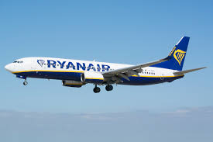
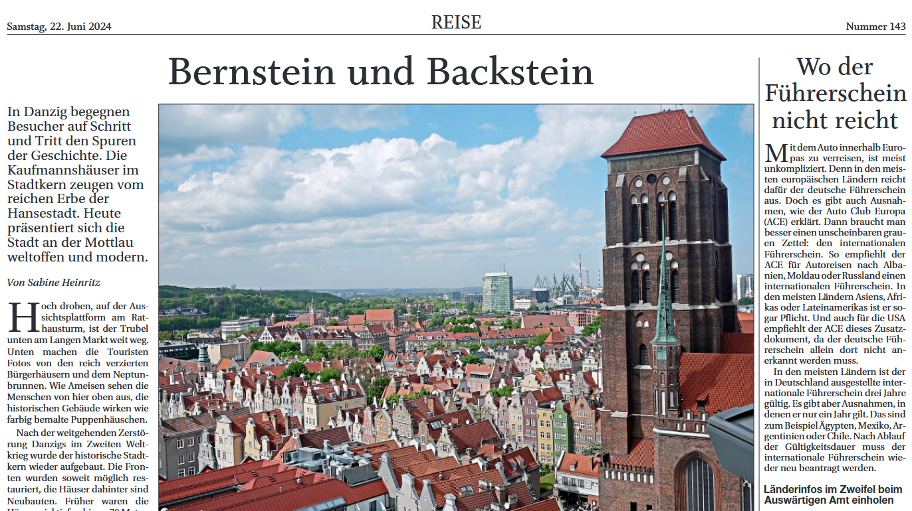
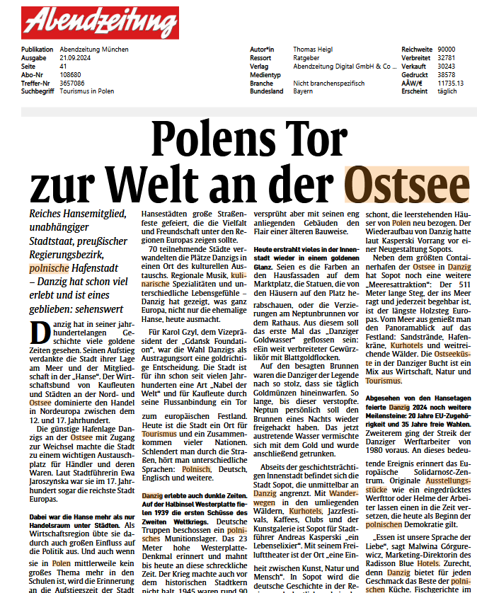

Foreign promotion
Direction Scandinavia
Sweden/Norway/Denmark
New flight connection - to Skellefteå (Sweden) from 2 April twice a week, on Tuesdays and Saturdays (Ryanair).
the only international connection Skellefteå Airport
potential of City Break promotion
promotional activities developed with ZOPOT Stockholm
visits by journalists/influencers/tour operators
Direction Germany
Cooperation with ZOPOT Berlin.
On 08-11.05 we hosted a large study visit by journalists from Germany: Fuldaer Zeitung, RND Redaktion Netzwerk Deutschland, Sächsische Zeitung,Schwäbische Zeitung, Augsburger Land, Passauer Neue Presse, Straubinger Tagblatt.
Participation in ITB Berlin
Membership in the Brick Gothic Route EUROB
Uczniowska 22, 80-530 Gdańsk tel. +48 58 305 70 80 got@visitgdansk.com www.visitgdansk.com

Slide 12

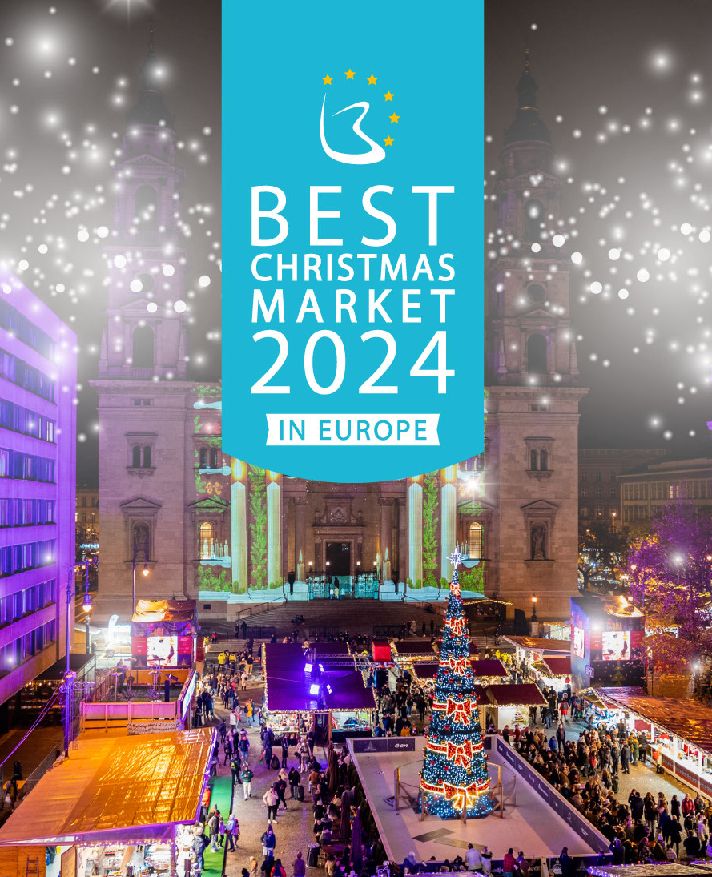

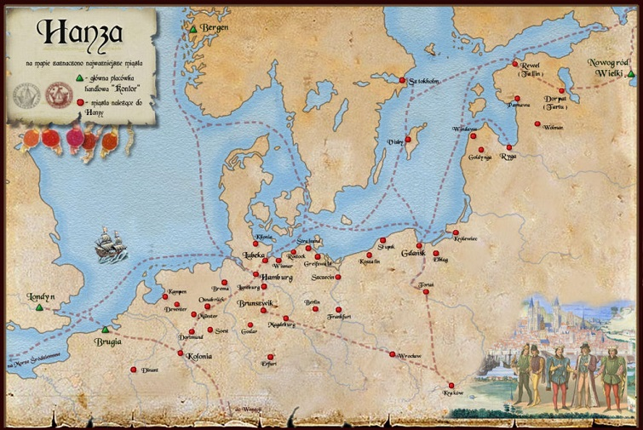
Events with GTO participation
St. Dominic's Fair:
increasing interest in the event among residents and tourists
directing traffic to Visit Gdansk stands and the Tastes of Gdansk stand (ministerial application, tasting portions for fair participants)
online promotion - directing traffic to event subpages on the Visit Gdansk website with a schedule of accompanying events
production of promotional films
Christmas Market and the “Best Christmas Market 2024” competition:
publications encouraging voting, advertising in social media and influencer marketing
mailings:
  using the GKM database and the Tourist Card
  to partners and GOT members with information about participation in the competition
  to local and national media (Radio ZET, RMF, Polskie Radio, Radio Gdansk, TVN, TVP, Polsat)to ROT, LOT and ZOPOT branches
  to the American Polonia (high percentage of competition votes cast in 2022)
Park & ​​Ride
encouraging the use of public transport and reducing car traffic in places popular with tourists
creating animations promoting Park & ​​Ride and providing instruction on how to use the zone
a campaign in Social Media showing the advantages of using Park & ​​Ride (free travel, convenient connections, accessibility, ecology)
a radio campaign
Behind us - a big event in 2024 - International Congress of Cities of the New Hansa - 13-16 June 2024
Help with accommodation for Hansa participants - 10% discount from 8 partner hotels
Expansion of the section dedicated to Hansa on the visitgdansk.com website - placing content in Polish and English
Creation of the brochure "Polish Cities of the Hansa" and promotional and information activities on Social Media Visit Gdansk
Creation of a thematic layout of the Tourist Card, which will act as an identifier for the Congress participants
Preparation and service of the stand during the event at Targ Węglowy (Coal Market)
Organization of 2 thematic walks for willing participants - on 14 and 15 June in the center of Gdansk in 3 languages ​​(Polish, English and German)
Uczniowska 22, 80-530 Gdańsk tel. +48 58 305 70 80 got@visitgdansk.com www.visitgdansk.com

Slide 13
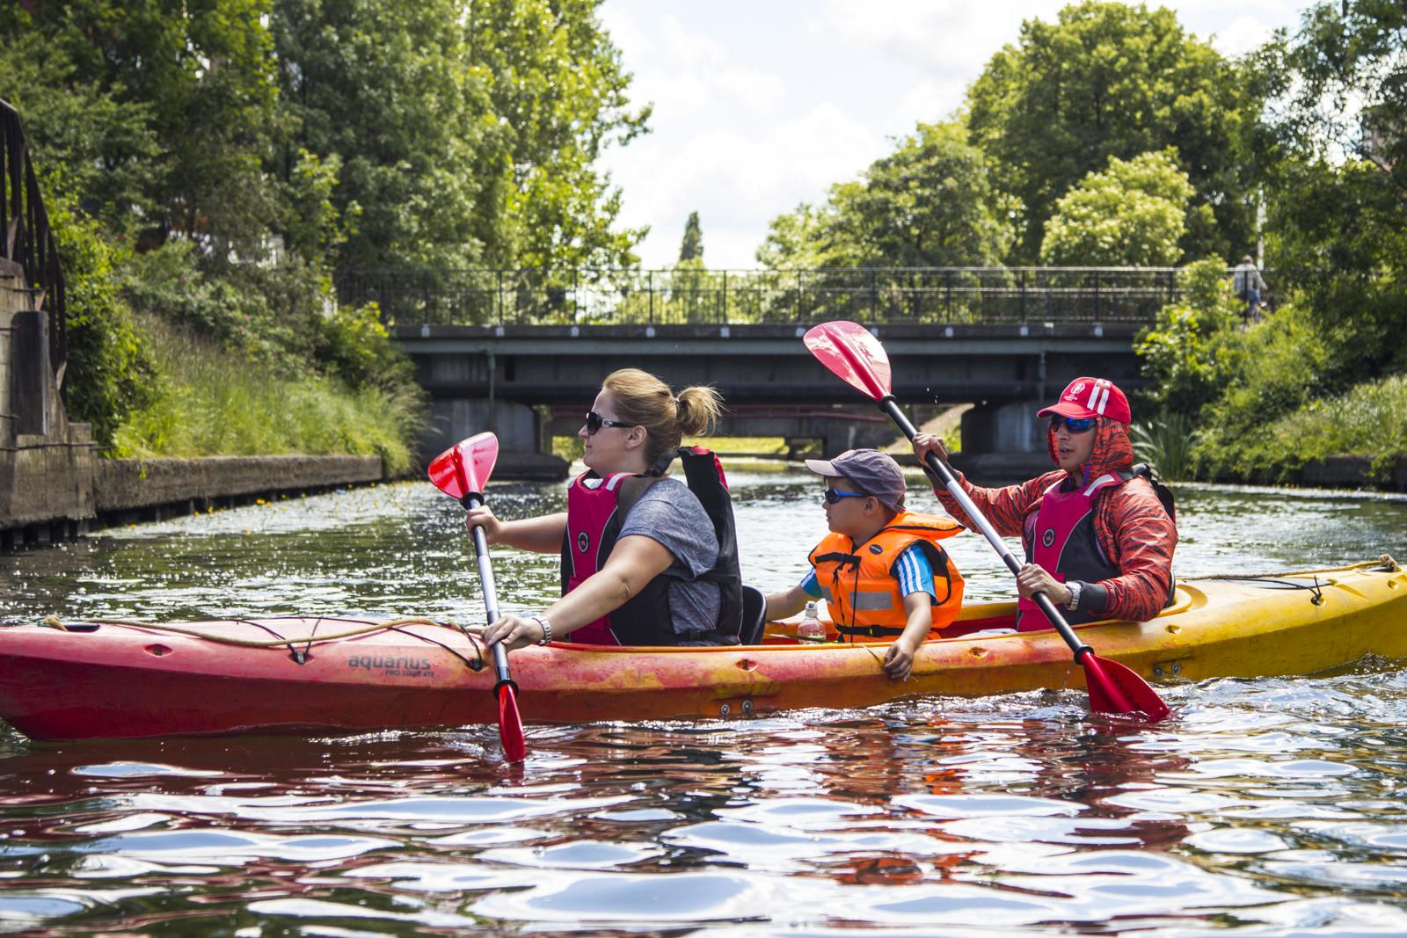
Sustainable tourism
Projects related to raising awareness of Sustainable Tourism:
participation in the GDS Index
improving the sustainability of our events (measuring carbon footprint, vegetarian catering, reducing single-use waste, including plastic, reducing food waste)implementing good practices for organizers as part of the Gdansk Support Program
monitoring residents' opinions on tourism
work on the economic impact of tourism
training for the industry: certification and EDI
Uczniowska 22, 80-530 Gdańsk tel. +48 58 305 70 80 got@visitgdansk.com www.visitgdansk.com

Slide 14
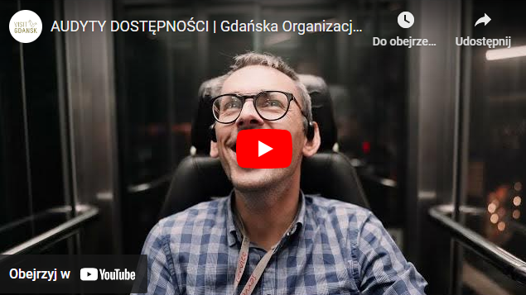
Accessibility Audits and Communication Card
Accessibility audits are a comprehensive assessment of barriers and facilities that affect the ability to freely use the space and offer of tourist facilities, carried out exclusively by people with disabilities. The aim of the project is to provide people with special needs with reliable information on the level of accessibility of the tourist offer, and to provide facilities with recommendations allowing for the implementation of specific improvements. 126 audits were carried out in 12 facilities and urban spaces.
The communication card is an universal tool for breaking down communication barriers. It facilitates the transmission and reception of messages, eliminating language, cultural and other barriers that may occur in traditional verbal communication. It supports both sides of the action: service and the customer. Cards for tourist facilities and tourist information were created.
GTO produced films devoted to issues related to accessibility, including audits and the Communication Card.
Uczniowska 22, 80-530 Gdańsk tel. +48 58 305 70 80 got@visitgdansk.com www.visitgdansk.com

Slide 15

Statistics
We track, estimate, and count:
the number and occupancy of accommodation (traditional and short-term rental)
the size and structure of tourist traffic
the behavior of guests and residents in the area of ​​leisure time (KT and GKM)the size of the MICE market
the social impact of tourism - opinions of residents on tourism
the economic impact of events
the size of the tourism industry
the availability of tourist attractions and cultural institutions for people with special needs
Uczniowska 22, 80-530 Gdańsk tel. +48 58 305 70 80 got@visitgdansk.com www.visitgdansk.com

Slide 16
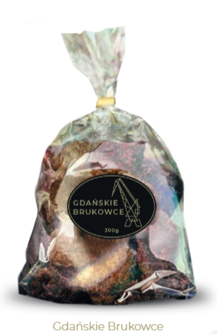
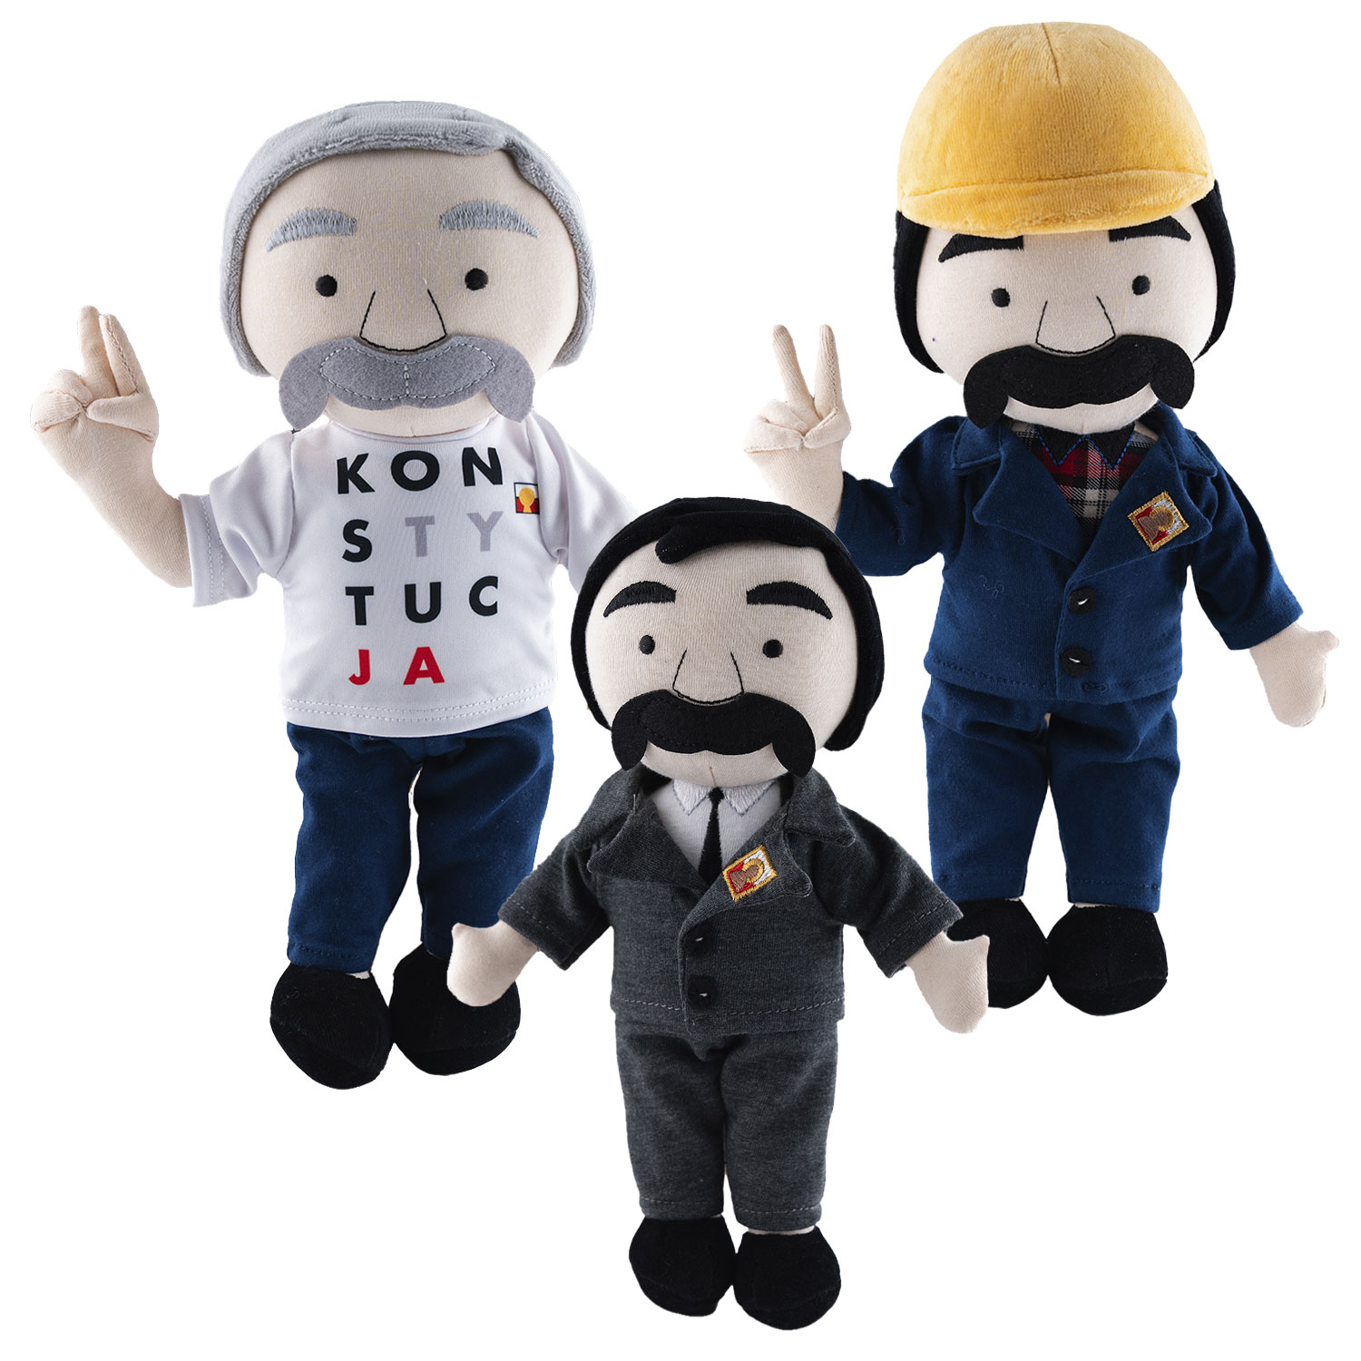
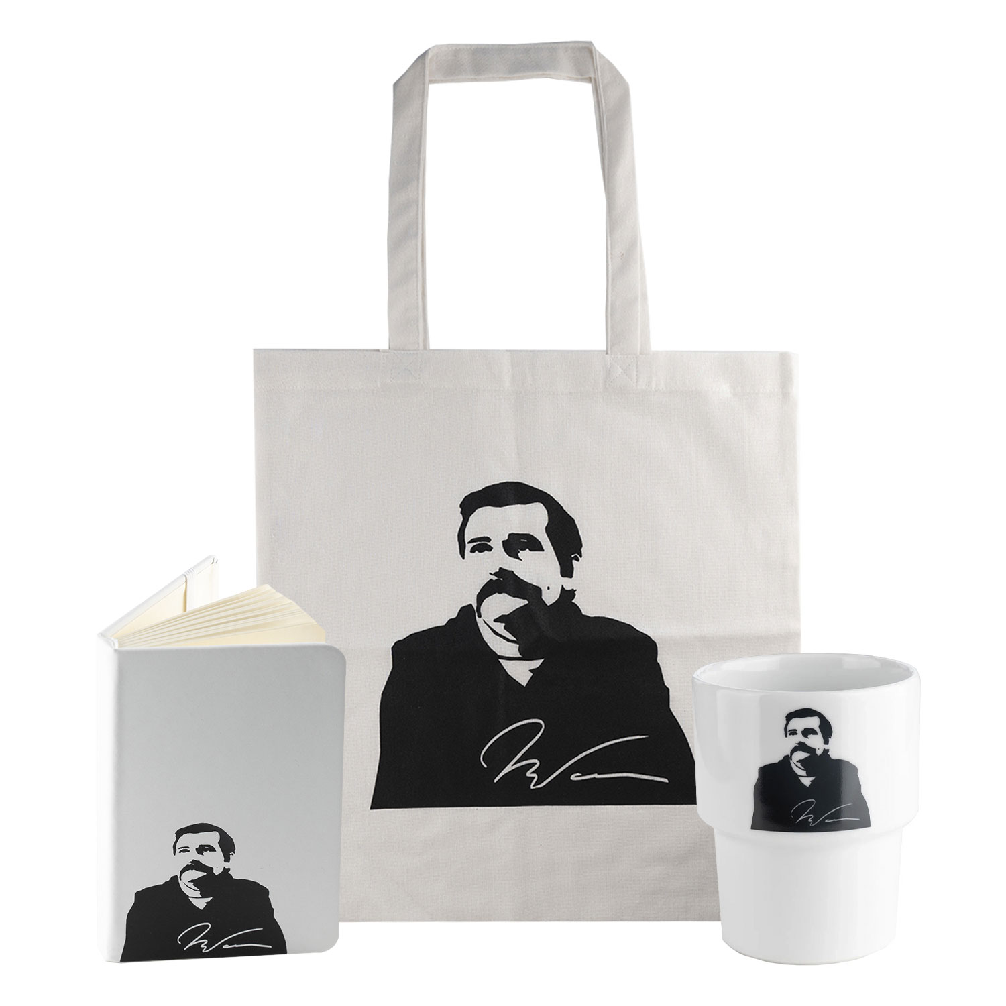

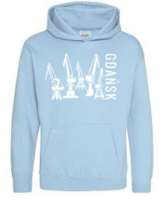
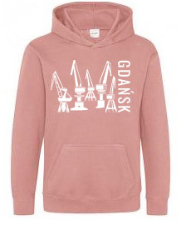

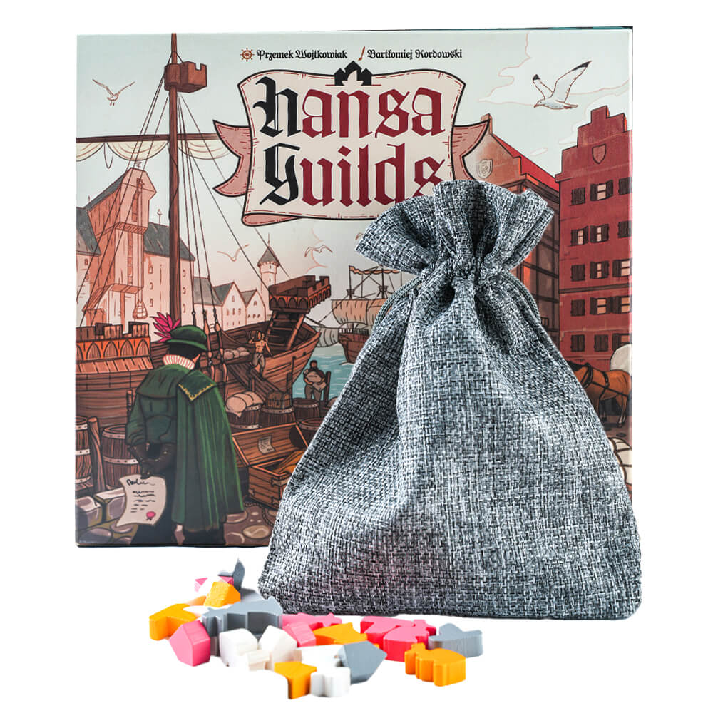

Sale
Mission:
Building relationships with customers, providing professional service and satisfaction with the solutions we provide.
Vision:
Striving to become a regional leader, we want to provide our customers with the highest quality products and services.
Employees are passionate about our company, work and life. We are confident in the quality of the brands we promote.
Creating and implementing a purchasing policy related to sustainable development: The aim is to support the implementation of the strategy of the Gdansk Tourist Organization, by managing purchasing categories, building a modern management culture and operational excellence, taking care of the sustainable development of the supply chain and sales.
Our road map is based on an implementation plan that focuses on the "from manufacturer to customer" approach and assumes the involvement of all parties in the value chain, including our customers.
The purchasing area uses the services of carefully selected suppliers. As part of the continuous improvement of purchasing processes, it develops and standardizes the processes related to their selection.
Uczniowska 22, 80-530 Gdańsk tel. +48 58 305 70 80 got@visitgdansk.com www.visitgdansk.com

Slide 17
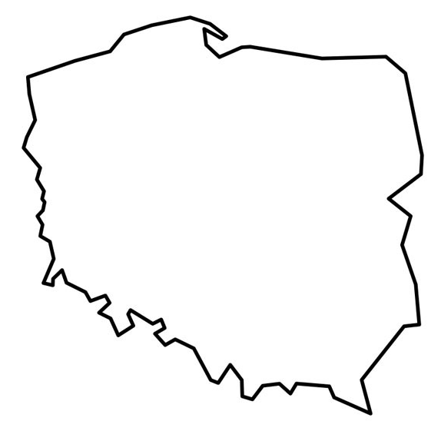
OneCard
One universal platform that integrates various city and commercial services, provides access to information and builds knowledge, identity and user engagement in the spirit of equality and accessibility.
Platforms for residents and tourists based on the OneCard system operate in over 40 cities throughout Poland and are used by over 1.5 million users.
Uczniowska 22, 80-530 Gdańsk tel. +48 58 305 70 80 got@visitgdansk.com www.visitgdansk.com

Slide 18

OneCard
integrated system based on software as a service (SAAS), connecting cultural institutions, recreational facilities, educational institutions, local government units, NGOs, social programs and other city projects
a tool for solving real problems of cities based on actual data
a research tool allowing for collecting and analyzing demographic and statistical data
a platform for conducting public opinion surveys
resident = tourist: shaping the attitude of a resident as a local tourist and compensating for inconveniences
resident = ambassador: image offer of the city for residents, developing knowledge of its culture and history, building local identity and activating users
"city Intranet": a unique communication tool with residents directly in OneCard channels
a platform presenting the offer of spending free time in the city based on a centrally managed calendar of events with the possibility of downloading items from other calendars and selling tickets
a nationwide leader and a project recognizable in Europe
Uczniowska 22, 80-530 Gdańsk tel. +48 58 305 70 80 got@visitgdansk.com www.visitgdansk.com

Slide 19











OneCard – Resident’s Card
Uczniowska 22, 80-530 Gdańsk tel. +48 58 305 70 80 got@visitgdansk.com www.visitgdansk.com

Slide 20

OneCard – Resident’s Card
345 000
people have an account in the Gdansk Resident’s Card system
195 000
users use the „I'm from Gdansk” application
135 000
times free entry or discount was used in Gdansk in 2024
Uczniowska 22, 80-530 Gdańsk tel. +48 58 305 70 80 got@visitgdansk.com www.visitgdansk.com

Slide 21
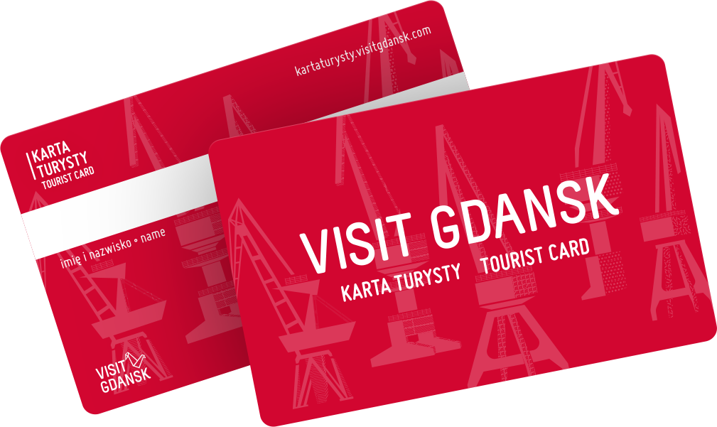
OneCard – Tourist Card
The Gdansk Tourist Card is a special system created for tourists visiting Gdansk and its surroundings.
It allows for easier sightseeing in the city, providing entry to tourist attractions and museums as part of paid time packages, as well as discounts in selected restaurants, shops and other facilities offering services for tourists.
The Gdansk Tourist Organization offers the following packages: Discoverer and Premium Discoverer, which differ mainly in the number of attractions included.
The system also allows you to buy a ticket for public transport, which allows you
to travel around the entire Tri-City.
Additionally, the system is connected to the Premium Services of Gdansk Airport
- it is used to sell and service Fast Track and Executive Lounge services.
Uczniowska 22, 80-530 Gdańsk tel. +48 58 305 70 80 got@visitgdansk.com www.visitgdansk.com

Slide 22

OneCard – Tourism Card
What does a tourist receive?
1. Paid package that includes:
the possibility of visiting 26 tourist attractions/museums without additional fees
the possibility of obtaining discounts in over 30 partner facilities
2. An account in the system, thanks to which you will be able to:
use additional possibilities, e.g. sightseeing routes in the application
manage your data and consents
receive notifications and a newsletter informing about new products
The Tourist Card is available both as part of direct sales at GOT's own points, at partner points and in online sales through the website kartaturysty.visitgdansk.com and through the mobile application - Tourist Card.
Uczniowska 22, 80-530 Gdańsk tel. +48 58 305 70 80 got@visitgdansk.com www.visitgdansk.com

Slide 23
OneCard – Tourist Card
17 053
Packages sold in 2024
750 000
Views of kartaturysty.visitgdansk.com in 2024
15 697
Taking advantage of free entries or discounts under the Tourist Card in 2024
Uczniowska 22, 80-530 Gdańsk tel. +48 58 305 70 80 got@visitgdansk.com www.visitgdansk.com

Slide 24
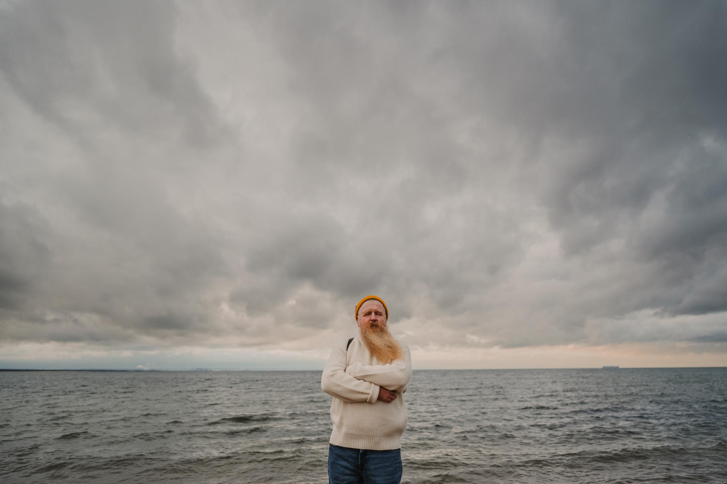

Thank you!

